Slide 1
Increasing the Opportunity to Learn Within ESSA and Beyond
Schott Foundation For Public Education
Education Justice Network
Communities for Just Schools
Southern Echo
Presented by:
Tanya Clay House
Beth Glenn
Jaime Koppel
Marilyn Young
Prepared by Tanya Clay House
for Schott Foundation for Public Education

Slide 6
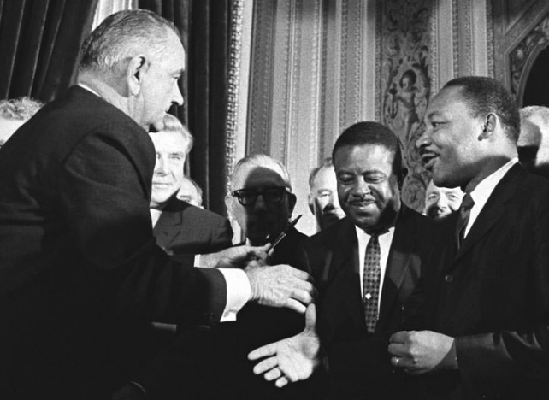
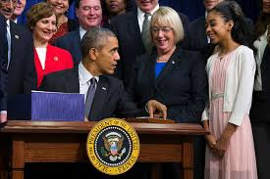
Education as a Civil Right ESSA Overview
The Elementary and Secondary Education Act of 1965 is a civil rights law.
It was passed during the era of the major civil rights protests that resulted in the passage of the Civil Rights Act of 1964 and the Voting Rights Act of 1965
The Every Student Succeeds Act (ESSA) allows States and districts much more flexibility.
However, requirements in the law still provide meaningful and effective ways to ensure that all students are equitably served by the States and districts. States and districts have the flexibility to go beyond the minimum requirement within ESSA to ensure educational equity and opportunity for all students.
While the ESSA Title I Regulation finalized under the Obama Administration was repealed by Congress, the responsibilities of the State and Local Districts under ESSA remain. The protection of the civil rights of all students served by public schools still remains the part of the mission and a priority of the U.S. Department of Education.
Notes:
Good afternoon and good morning to everyone.
Thank you for taking this time to join us as we discuss how each of you can more impactful as your states and district engage in the implementation of the Every Student Succeeds Act.
We know that this process can seem overwhelming which is why we are hosting this webinar to assist stakeholders in their efforts to be effective advocates within this entire process

Slide 7
Critical Implementation Deadlines
State Plan Submission
April 3, 2017
September 18, 2017
Identification of comprehensive and targeted support schools
2018-2019 school year
Annual Report Card submission
December 31, 2018 (for 2017-18 school year)
States and districts may delay including per-pupil expenditure data in their report cards for an additional six months.
Notes:
17 states have already submitted and had plans approved

Slide 8
Equality of Opportunity in ESSA – Critical Focal Points for State and Local Advocates
The need for a Consolidated State Plan
Timeline for State Plan approval
Consolidated vs. Individual state plans
Meaningful consultation of stakeholders throughout all stages of process
Use of Title II and IV funds to create effective improvement strategies.
Ensuring Equity in the Accountability Plan
Multiple measures of accountability
Identifying lowest performing 5% of schools and low-performing student subgroups
Creating effective school improvement plans
Protecting vulnerable students
Transparency to the Community and Parents
Subgroup accountability
Identification of disproportionate rates of ineffective, out-of-field, and inexperienced teachers
Civil Rights Data Collection (CRDC)
Resource allocation

Slide 9
Ensuring Equity through State Plans
States are required to submit plans that:
Are comprehensive AND coordinated with other programs under ESSA
Build on the work of state equity plans
Include “meaningful consultation” of diverse group of educational stakeholders
Explains how the State:
will further early childhood education programs
will support districts to improve school conditions and deal with:
Bullying and harassment
Overuse of exclusionary discipline practices; and
Disciplinary practices that compromise student health and safety
Explain how low-income and minority children are not served at disproportionate rates by ineffective, out-of-field and inexperienced teachers
Measures the State will use to evaluate and publicly report this progress.

Slide 10
Ensuring Equity through Consolidated State Plans Use of Title II Funds
REMINDER States are required to submit plans that are comprehensive AND coordinated with other programs under ESSA
States and districts should coordinate services to address needs of schools identified for improvement.
Title II Guidance - “To eliminate any such disparities, an SEA and its LEAs should develop and implement strategies that are responsive to the root causes of those disproportionate rates.”
To receive Title II funds, states can require districts to describe how they will provide low-income students with greater access to effective teachers
Under ESSA, Title II funds can be used for:
Diversifying the teaching workforce
Creating incentives for effective teachers to teach in high-needs schools
Teacher training on issues related to conditions for student learning (e.g. peer interaction, drug/alcohol abuse and chronic absenteeism)
Professional development and cultural competency training

Slide 11
Ensuring Equity through Consolidated State Plans Use of Title IV Funds
Ways to Use Funds
Promoting community and parent involvement in schools
Providing school-based mental health services and counseling
Promoting supportive school climates to reduce the use of exclusionary discipline and promoting alternatives
Establishing or improving dropout prevention
Promoting access to accelerated learning opportunities, e.g. Advanced Placement (AP)
Supporting re-entry programs and transition services for justice-involved youth
Implementing programs that support a healthy, active lifestyle (nutritional and physical education)
Implementing systems and practices to prevent bullying and harassment
Title IV Guidance
“The Department notes that ensuring all students have access to a holistic well-rounded education is central to the shared work across programs in ESSA.”

Slide 12
Ensuring Equity through Consolidated State Plans Stakeholder Questions to Ask:
FRAMING QUESTION:
How is the state using ALL ESSA funds to address the needs of the whole child?
Is the state submitting a consolidated state plan? If not, why?
Is there a State process for final stakeholder consultation AND feedback before submission of the plan?
How will the State help districts receiving Title I assistance improve school conditions?
How is this facilitated through the State plan and what is monitoring and oversight is there?
What is the timeline and process for additional corrective action if little progress is shown?
In order to receive Title II funds, will the State require districts to provide a strategic plan that outlines how the district will ensure that minority and low-income students will not be taught at a disproportionate rate by ineffective, out-of-field, and inexperienced teachers?
How is the State working with parents and the community to support the recruitment and retention of an effective and diverse teacher workforce in high-need schools?
Is the State and district using Title IV funds for justice-involved youth?
How is the State and district using Title IV funds to ensure students are well-rounded? (course access beyond basics, physical and emotional well-being of children)

Slide 13
Ensuring Equity through Accountability Requirements
Under ESSA, States have flexibility on how to most effectively
measure strengths and weaknesses
Multiple measures of accountability include:
Graduation rates (high school only)
Student Growth (elementary and middle school)
Or, another indicator that meaningfully differentiates school performance
Proficiency
English Language Proficiency (ELP)
School Quality
May include indicators such as chronic absenteeism
Discipline rates

Slide 14
Ensuring Equity through Accountability Requirements Stakeholder Questions to Ask
FRAMING QUESTION:
Does this plan most effectively measure the strengths and weaknesses of the school and student performance?
How does the accountability plan include the school quality indicator? What is/was the process for defining the indicator and how will this affect subgroups – particularly African American and low-income students?
How is the plan identifying and addressing the disproportionality of ineffective, out-of-field and inexperienced educators teaching low-income and minority children?
What is the process and timeline for assessing progress and providing additional corrective action?
Notes:
Explain difference between identifying issues in the plan versus allocation of resources
(Bullet 2: This is addressed on slide 8; maybe remove there and discuss here, in less crowded slide?)

Slide 15
Ensuring Equity through Identification of Schools Needing Improvement and Student Subgroups
By FY 2018-19 – SEA must identify 2017-18 schools for comprehensive support and improvement and those for targeted support
Comprehensive Support and Improvement Schools
State identifies one category of lowest performing schools for comprehensive support and improvement:
The lowest-performing 5% of all schools (at least, can be more)
All high schools with 67% or less graduation rate
Identification must be done at least every 3 years (could be done annually).
Targeted Support Schools
State identifies schools with consistently underperforming subgroups
Notes:
Beth Glenn begins

Slide 16
Ensuring Equity through School Improvement Funds and Plans
States Must Allocate Funds for
Identified Schools
Targeted and Comprehensive Improvement Plans Must Be Developed by Districts
States must allocate at least 95% of their Title I funds to districts to support identified schools
States must prioritize districts that:
Use funds for identified schools
Show greatest need for funds
Show strongest commitment to using funds to improve achievement and outcomes
A district’s plan must describe how it will support identified schools and monitor improvement in schools receiving Titile I funds
In consultation with principals, teachers and parents
Using evidence-based practices
Focusing on all indicators and low-performing subgroups
Focusing on resource inequities to be addressed through implementation of the plan

Slide 17
Addressing Resource Inequities Through District Plans
Needs Assessments
Turnaround plans should be responsive to identified needs
Fund turnaround plans using the state’s Title I set asides
At least 7% state’s Title I money for school improvement and
At least 3% for direct student services
advanced coursework, career technical ed and personalized learning
Fund teacher distribution gaps with Title II: PD, our of field, diversity
Fund turnaround using district’s Title IV set asides
20 % of district funding on at least one activity that helps students become well-rounded,
20 percent on at least one activity that helps students be safe and healthy
Ask: Is there an approved list of programs districts can use? Is there help for districts too under-resourced to fund something like ELO, RJ or community school coordinators, or an IB program on their own?
Notes:
- States could set aside up to 7 percent of all their Title I funds for school improvement, up from 4 percent in current law.
A further 3% set aside of Title I funds is allowed for “direct student services” such as AP, IB, advanced coursework, CTE and personalized learning
How is your state engaging around turnaround? Do districts have to apply? Is there an approved list of programs districts can use? How are they helping districts who may be too under-resourced to fund something like an IB program on their own? State funds for ELO or CBOs to engage? RJ coordinators and parent liaisons?
Districts receiving at least $30,000 have to spend at least 20 percent of their Title IV funding on at least one activity that helps students become well-rounded, and another 20 percent on at least one activity that helps students be safe and healthy

Slide 18
Ensuring Equity through School Improvement Funds and Plans Stakeholder Questions to Ask
How long must a subgroup be “consistently underperforming” to be identified as in need of comprehensive or targeted support?
Will underperformance prior to 2017-18 be considered by the State in its identification process?
What is the State process for determining the which type of schools will be considered in need of comprehensive support?
Will the State be providing direct services to identified schools?
How has the State decided to allocate school improvement funds?
What is the process for parental and community stakeholder consultation during the district development of the school improvement plan? Will there be opportunity for feedback before final approval?
What is the process for oversight of the district improvement plan?

Slide 19
Threats to Resource Equity in Proposed Administration Budget
$9.2 billion or 13.5% proposed cuts
most negative impact on poor and those seeking to join middle class
bait and switch: cuts from programs for traditional schools and then gives $ if use vouchers
Administration’s priority on vouchers could be enacted through portability in Title I
Net cut to Title I, where money already follows children in public system
States can opt in to $1.4 billion in funding where federal money follows child to private and religious schools through vouchers and other voucher-like programs, draining funds from public schools
Proposed elimination of all Title II supports for teaching
Transfers from and within Title IV that negate set-asides
Transfers to Title I for undesignated spending, possibly to fund voucher programs
Removal of set asides for 21st Century Community Learning Centers, Comprehensive Literacy Development, American Indian Education and 21 other initiatives
Leaves tech as suggested spending which can drain funds from more pressing human needs that might impact student learning more
Notes:
- Biggest threat is not enactment as-is, but smaller cuts that are still damaging but seem reasonable by comparison.
- More teachers to reduce class size, professional learning helps young teachers get better, veterans become more cult competent, time to perfect lessons; attract specialists in shortage areas like EL, special needs, advanced math, sci
ESSA allows for transfers so could boost voucher program, spend on tech like saw in LA, when needs were more pressing for RJ, social workers, offering chemistry and physics
Title IV is where you get Restorative justice, school social workers, community coordinators, Advanced science and history courses, expanded learning time, internships, CTE

Slide 20
Other Threats to Equity in the Budget
Innovation fund – will now do research on vouchers
$167M for charter expansion; $100M for facilities
Civil Rights Enforcement: 40 fewer positions at ED; modest increase at Justice
Community Oriented policing: $17.4M increase (funds many SROs)
IDEA: $100M cut
Medicaid
Impact on learning shown to be on par with smaller class sizes and performance standards
Pays a portion of school based staff: nurses, counselors, paraprofessionals, classroom aides
School-based services such as vision & hearing screenings
House proposal puts caps on state amounts; less federal money to states; lets states eliminate screenings
Notes:
- 230 M: innovation and research (formerly I3) for research about choice (predetermined conculsions); avail to religious and private schls
IN, OH, DC all show strong neg results from vouchers
- 167M for charters of which 100m = facilities; makes permanent, compete with public schools, makes pub schls obsolete or unlikely to be refurbished; fund for CMOs, which have tendency to cream off lotsa $; replicate charters working well 400M
- OCR: no change in funds, allocation shifts: loss of 40 positions at OCR;
CR division at Dept of Justice very modest increase
Comm Oriented Policing = funds many SROs: 17.4M increase, no details on allocation
IDEA: even level funded (with CR) = half appropriated amt
Medicaid:all children get early screening treatment and diagnostic services; any treatement deemed medically necessary (like assistive devices) must be provided and medicaid pays as req'd by law

Slide 21
Ensuring Equity Through the Budget: Stakeholder Questions to Ask
Has your state informed Congress how cuts to funds for disadvantaged kids (Title I) and elimination of support for teaching (Title II) will impact students?
How will your state respond to funding cuts for disadvantaged students (Title I) and students with disabilities (IDEA)?
Will your state opt-in to the portability plan if offered?
How will your state and district keep focus on important supports such as afterschool, literacy assistance, internships and advanced coursework (Title IV)
What safeguards exist to make sure charter expansion and facilities spending doesn’t negatively impact the existing school system?
How will your state pay for the lost supports in schools if Medicaid is cut? Will they raise taxes? Cut other services?
Notes:
- Medicaid = 57% of fed money going to states ; more than transpo and hier ed. etc combined;

Slide 22
Ensuring Equity of Vulnerable Populations
ESSA includes expanded requirements for the protection of vulnerable populations:
Homeless Youth
Foster Care Youth
Delinquent and Neglected Youth
Stakeholder Questions to Ask:
How is the district addressing the needs of homeless youth awaiting foster care, as newly required in ESSA?
What is the process to ensure the transportation needs of homeless and foster youth?
What is the district plan for incorporating supports for the needs of justice-involved youth?
Are supplemental services being incorporated into district school improvement plans? See Title IV Guidance Section below

Slide 23
Ensuring Equity through Data Transparency:
To help ensure that parents contribute to decisions, ESEA requires that States and districts consult with parents in developing report cards. (ESEA section 1111(h)(1)(B)(ii))
Highlighted Requirements
Description of, and results from, the State accountability system
Student achievement on the academic assessments
Information collected and reported in compliance with the CRDC under 20 U.S.C. 3413(c)(1)
Information on educator qualifications
A list of all the districts and schools that received school improvement funds, including the amount of funds each school received and the types of strategies implemented in each school with such fund
Information on per-pupil expenditures
Any Other Information That the State Deems Relevant

Slide 24
Ensuring Equity through Data Transparency: CRDC Reporting Requirements
ESSA requires that State and district report cards include data from certain CRDC data categories measuring school quality, climate, and safety, including information of the following:
In-school suspensions
Out-of-school suspensions
Expulsions
School-related arrests
Referrals to law enforcement
Chronic absenteeism, including both excused and unexcused absences
Incidents of violence, including bullying and harassment
In addition, State and district report cards must include the number and percentage of students enrolled in preschool programs and accelerated coursework to earn postsecondary credit while still in high school for all students and each student subgroup.

Slide 25
CJSF ESSA Grassroots Initiative
- $1 million initiative
- State and local grassroots advocacy initiative for robust and equity-focused implementation of the Every Student Succeeds Act.
- Develop positive, safe, and nurturing learning environments for every child, particularly those most marginalized.
- Coordinated education and expansion of a national network of community organizers PLUS targeted resources and technical assistance support to organizing groups in Boston, Dayton, and Mississippi Delta
- Well-informed, well-resourced, well-connected community advocacy efforts for draft state plans and equitably funded interventions that will help eliminate racial disparities in school discipline and create healthy school climates

Slide 26
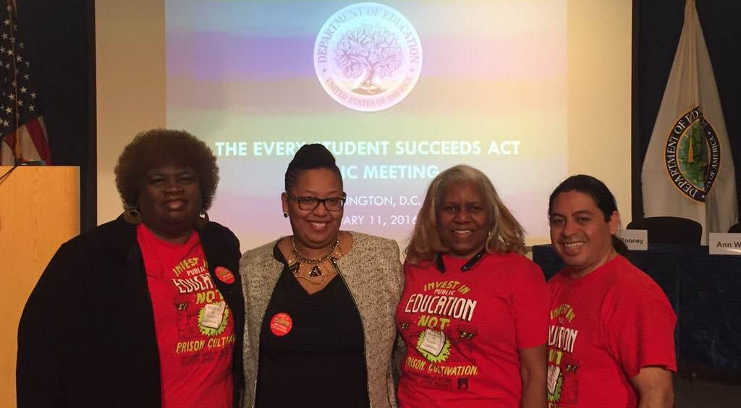
ESSA Initiative Partners
Mississippi Delta
Southern Echo
Citizens for a Better Greenville
Nollie Jenkins Family Center
Tunica Teens in Action

Slide 27
ESSA Initiative Partners
Dayton, OH
Racial Justice NOW!
Boston, MA
Youth on Board/Boston Student Advisory Council

Slide 28
Ensuring Equity through Data Transparency: Stakeholder Questions to Ask
How did the state present this information to stakeholders? Have you seen a version of this template?
What is the timeline to release the information to parents and the community during the school year?
How/will the discipline data be used to assess the effectiveness of state and local strategies developed to improve student achievement?
Does the report card design take into account feedback provided through the required parental and stakeholder consultation?
Is the report card easily accessible?

Slide 29
Charter Schools and Ensuring the Opportunity to Learn Stakeholder Questions to Consider:
What is in your state charter law?
Does the state charter law provide less or additional civil rights protections for students and teachers in the classroom? (ex. D.C.’s Human Rights Act provides additional anti-discrimination protections based on gender, sexual orientation, marital status, etc.)
What is the governing body over Charter schools and is there opportunity for engagement?
How is the State and/or District ensuring transparency of information within charter schools?
As public schools, charter schools still fall within the ESSA accountability requirements structure

Slide 30
Diversity in the Classroom and Workforce Stakeholder Questions to Consider:
Does your district have a school assignment plan that considers race or socio-economic status?
Does the district utilize magnet schools? What are their demographics in the school AND in the classroom?
Is there consideration of racial and/or socio-economic diversity within the state ESSA accountability plan?
Are there specific strategies in place or in development to recruit and retain teachers of color?

Slide 31
Wrap-a-round Services and Supports Stakeholder Questions to Consider:
Does the district utilize 21st Century Community Learning Center grants to fund afterschool programs or does funding primarily come from state resources? If so, what are the demographics of those utilizing these services?
What additional federal grants (ex. I3 grants) does the district utilize to provide wrap-around services such as health screenings, counseling, tutoring, etc.?
Are these services considered as part of the ESSA school improvement plans?

Slide 32
Final Questions to Consider:
If the State submitted a plan by April 3, 2017:
Who will be the primary contacts for stakeholders at the State and district after the plan is submitted?
Once schools for comprehensive and targeted support are identified, how does the district plan to engage parents and stakeholders in the development of the improvement plan?
Is the district considering positive school climate strategies in the development of its school improvement plan?
Is the State coordinating additional ESSA programs in Title II, Title IV and others to supplement needed resources for schools identified for comprehensive and targeted support?
If the State is submitting a plan by September 2017:
Will the State be submitting a consolidated plan?
When are opportunities for parent and community input on the state plan?
What process is the State using to determine the best school quality indicators in the accountability plan?
How often will stakeholders be consulted during the planning process and what is the timeline for incorporating stakeholder feedback?
Is the State coordinating additional ESSA programs in Title II, Title IV and others in order to supplement needed resources identified in schools identified for comprehensive and targeted support?

